Slide 1
CLOUD GATEWAY
Mania Abdi
Rahul Bahal
Chienli Ma
Ayush Singh
Mentors:
Kyle Forster
Ted Elhourani

Slide 2
Original Goals
Establish a connection between a subnet and external network (Original)
Automating IPSec(StrongSwan) configuration (Original)
CloudFormation - AWS (New)
Heat - MOC (New)

Slide 3
The sprint in a Nutshell..
Initial Approach - Scripts for IPSec
CloudFormation - AWS
Heat - MOC

Slide 4
Goal Updated
Earlier thoughts were to create a composite automation package
AWS CloudFormation on Public and Heat API on Private MOC
Process is bifurcated between
First Initializing configured Instances
Use our Automation Suit to set up tunnels and Strongswan
Code pushed to Github repo

Slide 5
AWS Side: CloudFormation
A template which take some parameter to set up VPC, subnet, cloud gateway VM etc. for CloudFormation
A script for uploading template and monitor the creating progress to get rid of WebUI
Make use of IPsec automation script to set up tunnel between local machine and new VCG

Slide 6
AWS Side: CloudFormation
Use aws Python SDK -- boto3 to automate uploading process
We give up Ruby SDK -- Document outdated.
Current progress will be presented on demo

Slide 7
MOC Side: OpenStack Orchestration
Provide human and machine accessible service
A service to orchestrate composite cloud application
A template base API to describe a cloud application

Slide 8
Moc-Side: Openstack Orchestration
Heat engine launch the template and providing event back to the API consumer.
Heat tool is CLI to execute AWS Cloudformation APIs.
Heat API
Openstack native ReST API
Heat-api-cfn provide compatibility with AWS.

Slide 9
TRELLO

Slide 10
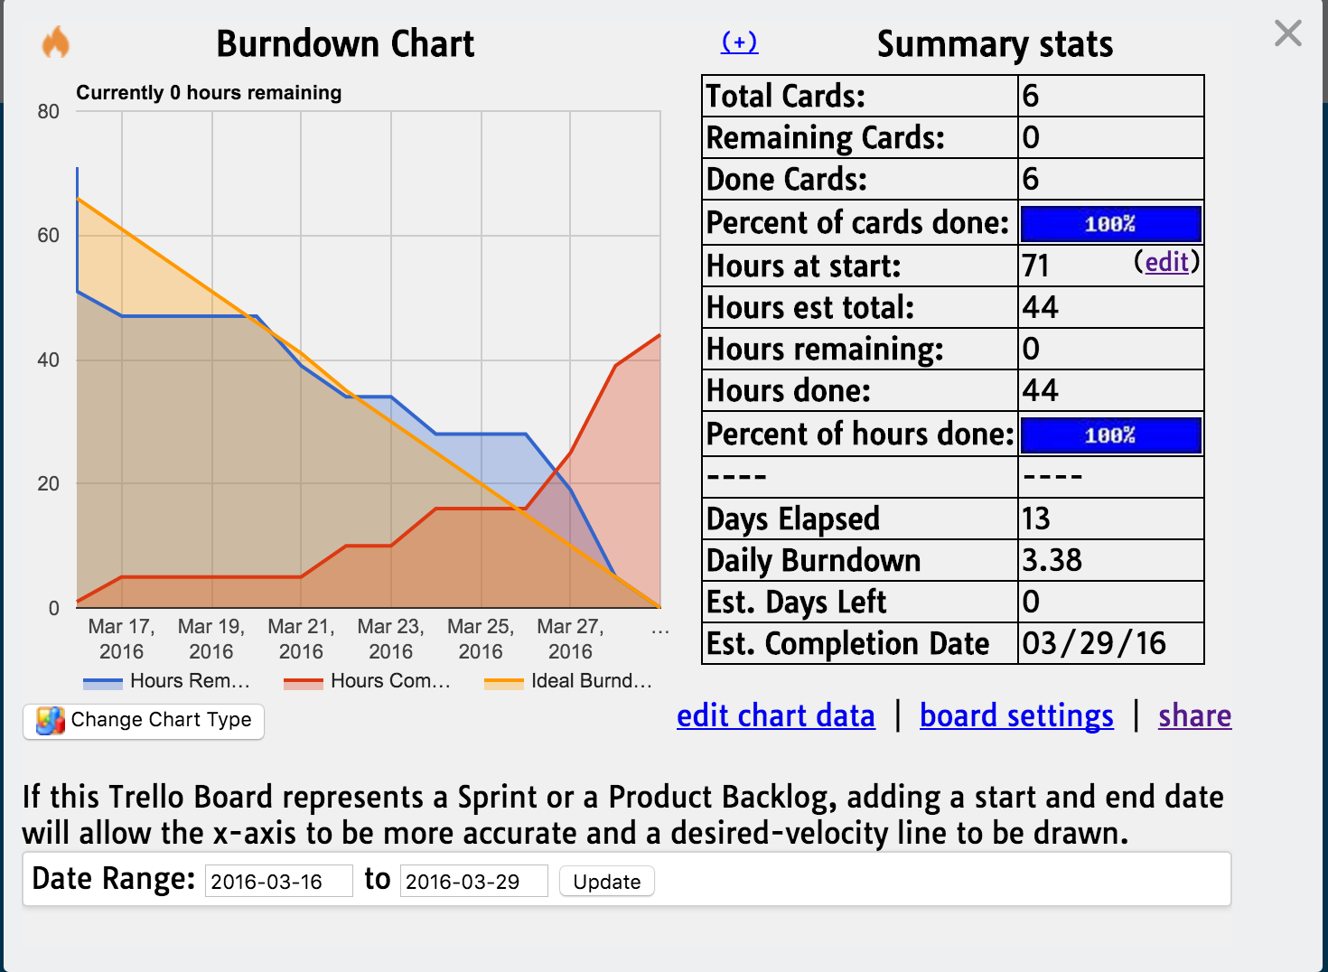

Slide 11
What's Next?
Configure Heat for MOC
Bug fixes
Discuss more goals with mentors e.g. Unify configuring CF and Heat

Slide 12
DEMO

Slide 13

Thank you!

